Slide 1

Computational Physics (PHYS6350)
Lecture 17: Random numbers
Reference: Chapter 10 of Computational Physics by Mark Newman
March 28, 2023
Instructor: Volodymyr Vovchenko (vvovchenko@uh.edu)
Course materials: https://github.com/vlvovch/PHYS6350-ComputationalPhysics

Slide 2
(Pseudo-)random numbers
Random numbers play important role, both in modelling physics processes (some of which are regarded as truly random, such as radioactive decay) and as a tool to tackle otherwise intractable problems.
Examples:
Numerical integration (especially in many dimensions)
Sampling microstates in statistical mechanics
Simulating quantum processes
Monte Carlo event generators
Numbers generated on a computer are not truly random, but a good generator produces numbers that reflect the desired properties of a random variable, hence they are called pseudo-random.

Slide 3
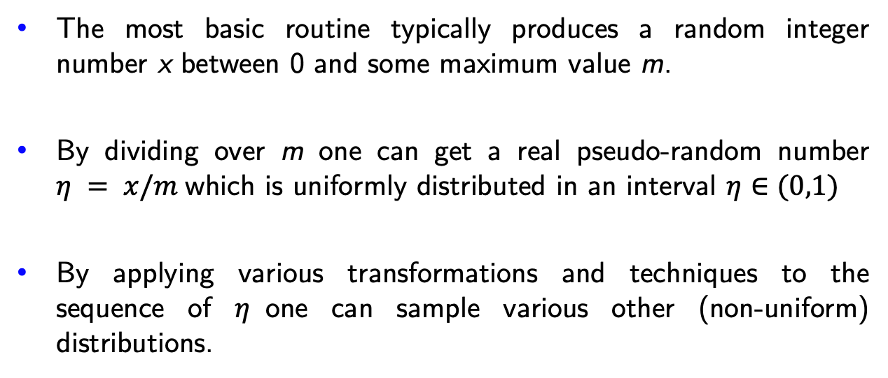
Pseudo-random numbers on a computer
The most basic routine typically produces a random integer number x between 0 and some maximum value m.
By dividing over m one can get a real pseudo-random number $η = x/m$which is uniformly distributed in an interval $η∈(0,1)$
By applying various transformations and techniques to the sequence of $η$one can sample various other (non-uniform) distributions.
How to sample pseudo-random numbers x?

Slide 4
Linear congruential generator
Historically, one of the simplest RNG is linear congruential generator (LCG)*.
It generates a sequence of pseudo-random numbers in accordance with an iterative procedure
for some parameters a, x, m.
The next number in a sequence depends only on the present one.
The sequence is periodic with a period of at most m
*Do not use LCG in any serious calculation(!)

Slide 5
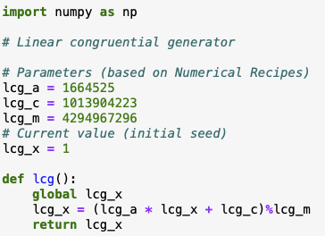
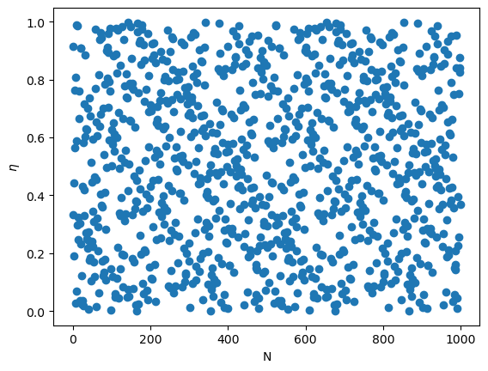
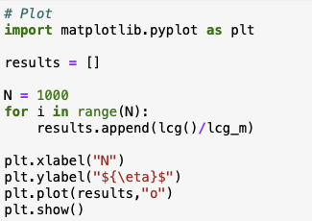
Linear congruential generator: Example

Slide 6
Linear congruential generator
LCG has some serious drawbacks:
Apart from a rather short period, it also fails many statistical randomness tests.
For instance, if one regards random numbers as components of a vector (x,y,…), the method tends to generate these points on a hyperplane (spectral test).

Slide 7
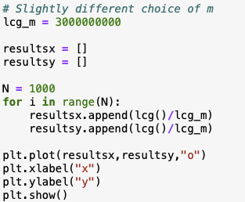
Linear congruential generator
LCG has some serious drawbacks:
Apart from a rather short period, it also fails many statistical randomness tests.
For instance, if one regards random numbers as components of a vector (x,y,…), the method tends to generate these points on a hyperplane (spectral test).

Slide 8
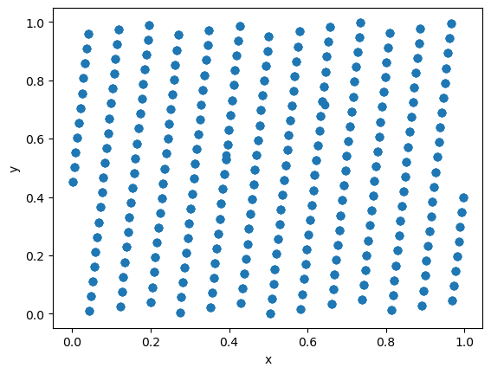
Linear congruential generator
LCG has some serious drawbacks:
Apart from a rather short period, it also fails many statistical randomness tests.
For instance, if one regards random numbers as components of a vector (x,y,…), the method tends to generate these points on a hyperplane (spectral test).

Slide 9
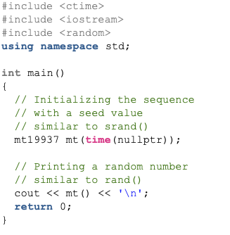
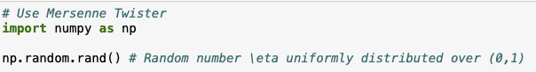
Mersenne Twister
LCG is not and should not be used in any serious calculations.
Other methods have been developed over the years and the general method of choice is Mersenne Twister random number generator which is implemented by default in many programming environments.
MT has a long period of 2¹⁹⁹³⁷ - 1, passes most statistical randomness tests, fast, and suitable for most physical applications.
It now implemented by default in many languages and we will take it for granted.
Python:
C++ (since C++11):

Slide 10
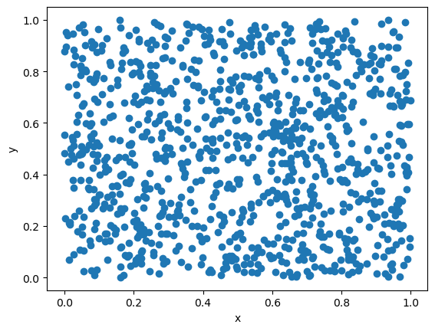
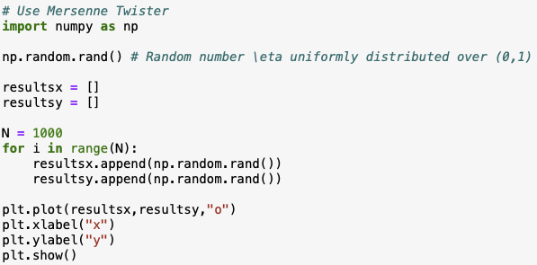
Mersenne Twister

Slide 11
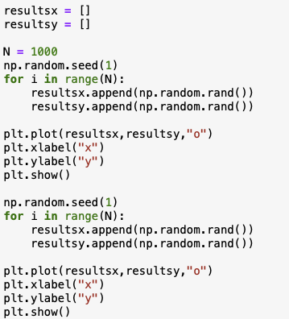
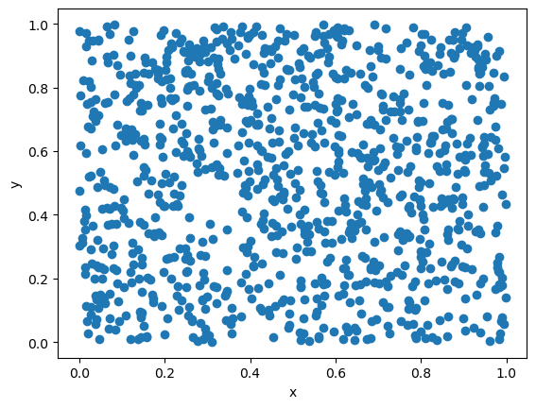

Random seed
Most RNGs (like LCG, Mersenne Twister,…) maintain state variables and
iteratively generate a pre-determined sequence of (pseudo)-random numbers
The initial state can be changed by specifying the seed
Running the program from the same seed will generate identical outcome
Using the same seed is good for debugging… but bad for parallel production runs on a cluster

Slide 12
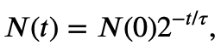
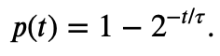
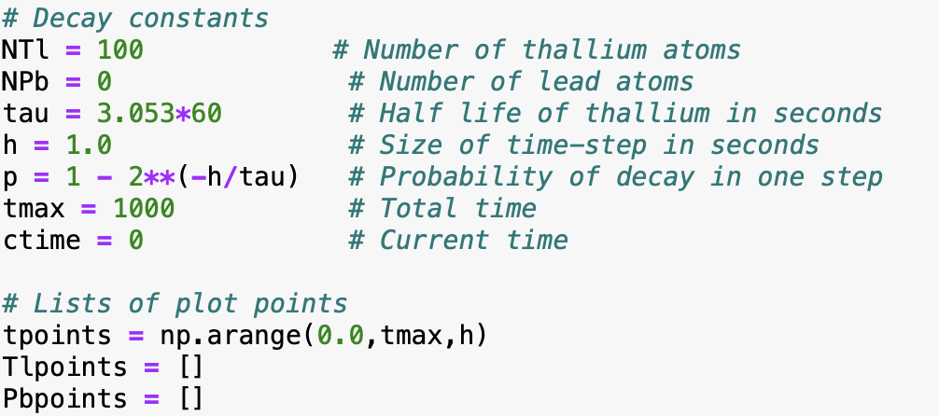
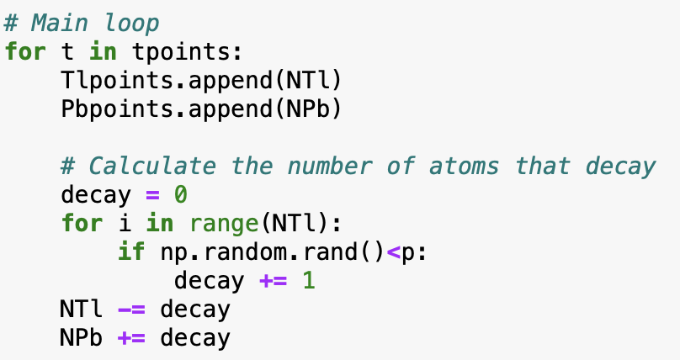
Simulation example: Radioactive decay
Example 10.1 from M. Newman, Computational Physics
Some physical processes are truly random (recall quantum mechanics), for instance radioactive decay
The number of radioactive isotopes with a half-life of $τ$ evolves as
therefore, the probability for a single atom to decay over the time interval t is
Let us simulate the time evolution for a sample of thallium atoms decaying (half-life of $τ$= 3.053 mins) into lead atoms.

Slide 13
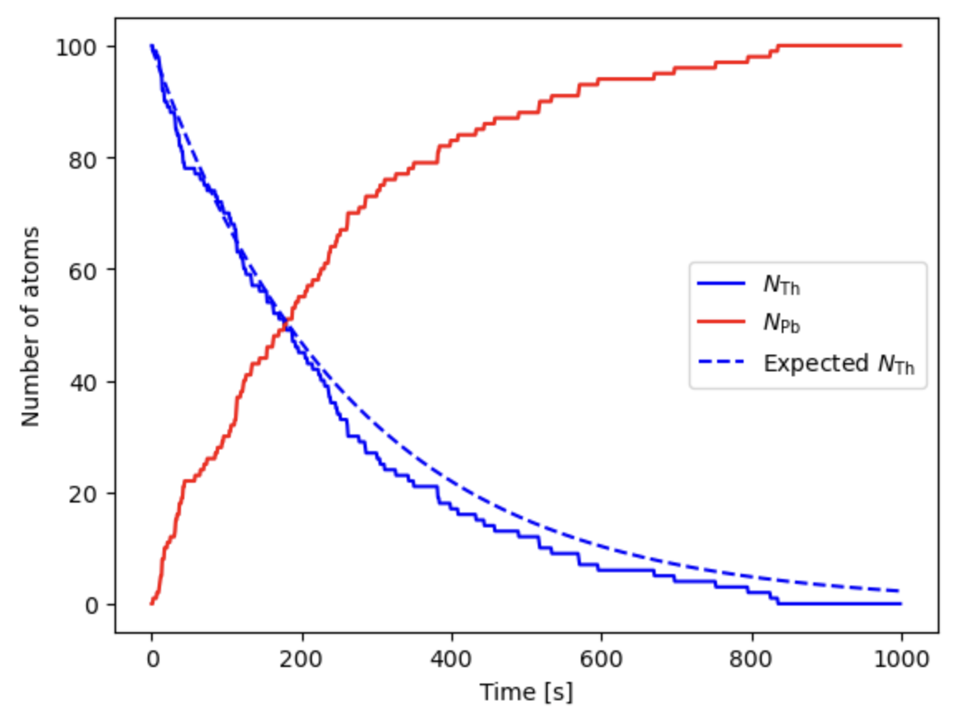
Simulation example: Radioactive decay
Expected:

Slide 14
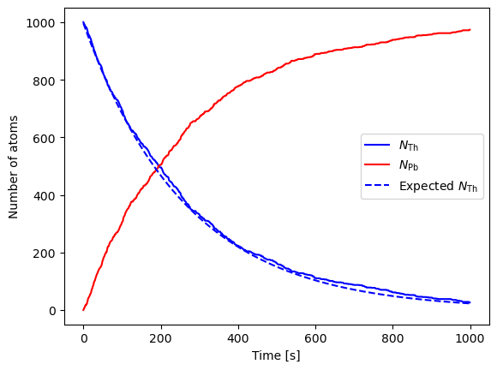
Simulation example: Radioactive decay
Expected:

Slide 15
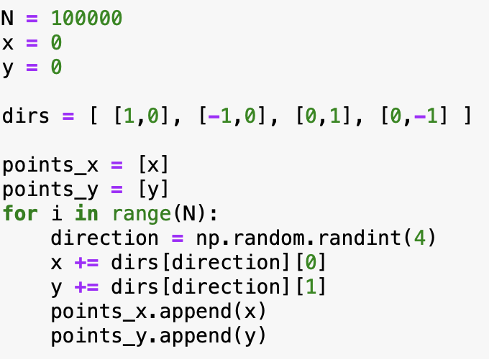
Simulation example: Brownian motion
Brownian motion is a motion of a heavy particle in a gas colliding with the lighter gas particles.
We can consider a simplified 2D motion of particle by randomly making
a small step at each iteration in one of the four directions.

Slide 16
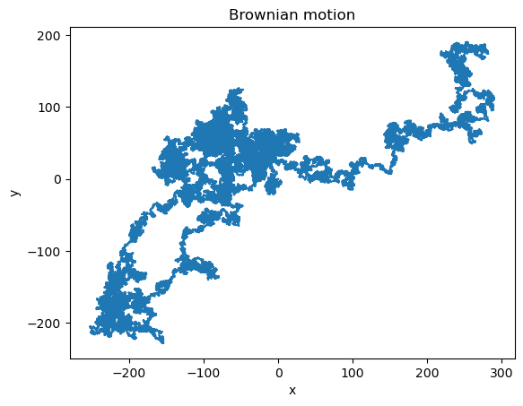
Simulation example: Brownian motion
Brownian motion is a motion of a heavy particle in a gas colliding with the lighter gas particles.
We can consider a simplified 2D motion of particle by randomly making
a small step at each iteration in one of the four directions.

Slide 17
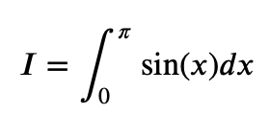
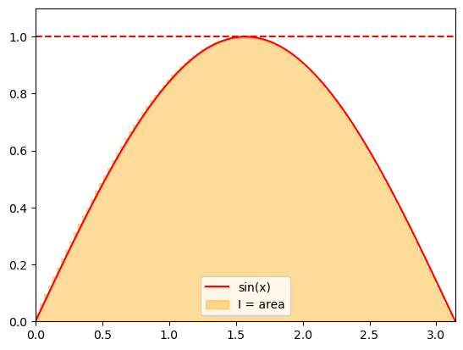
Computing integrals: Estimating the area under the curve
Recall the interpretation of a definite integral as the area under the curve.
We can use this interpretation to apply random numbers for approximating integrals.
Consider

Slide 18
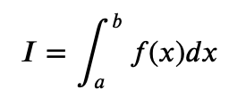
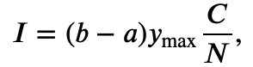
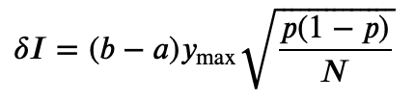
Computing integrals: Estimating the area under the curve
We can estimate the area by sampling the points uniformly from an enveloping rectangle and counting the
fraction of points under the curve given by the integrand f(x).
Assuming an integral
where f(x) > 0 and f(x) < y_{max}, the integrand can be evaluated as
where C is the number of the sampled points that fall under f(x).
The statistical error of the integrand can be estimated using the properties of the binomial distribution
with p = C/N:
The error scales with N^{-1/2}
To reduce the error by factor x2 we need to sample x4 more numbers – true for most Monte Carlo methods.

Slide 19
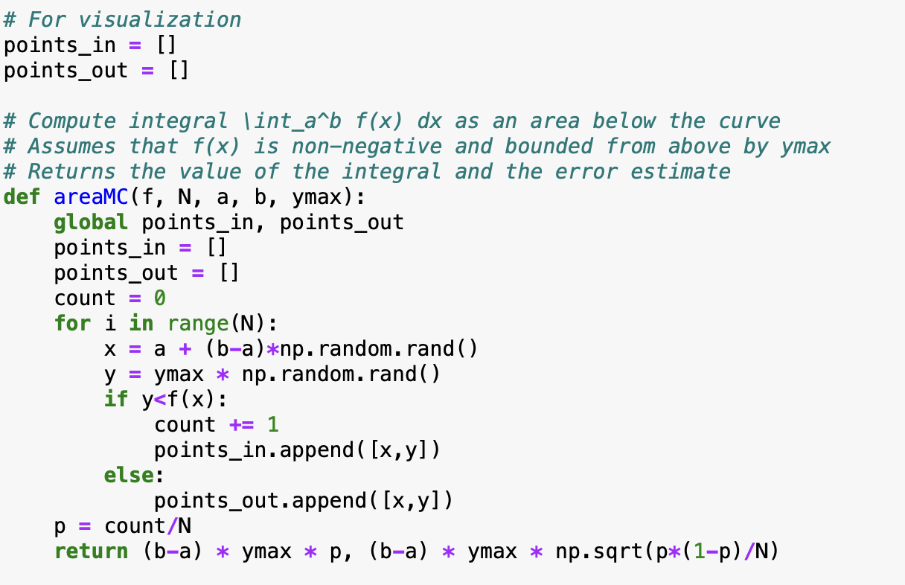
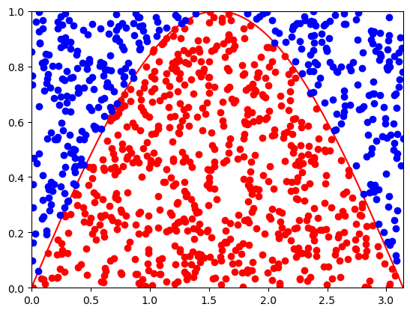
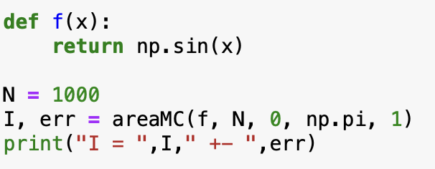
Computing integrals: Estimating the area under the curve

Slide 20
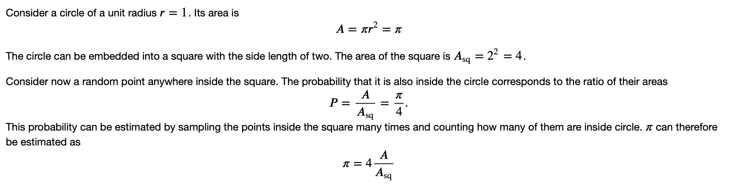
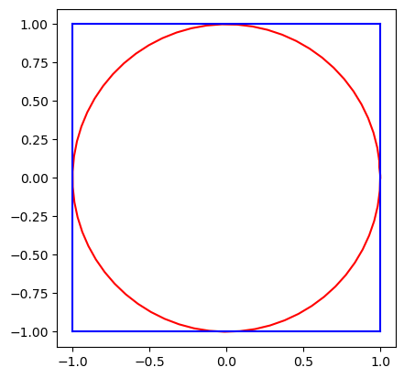
Computing pi

Slide 21
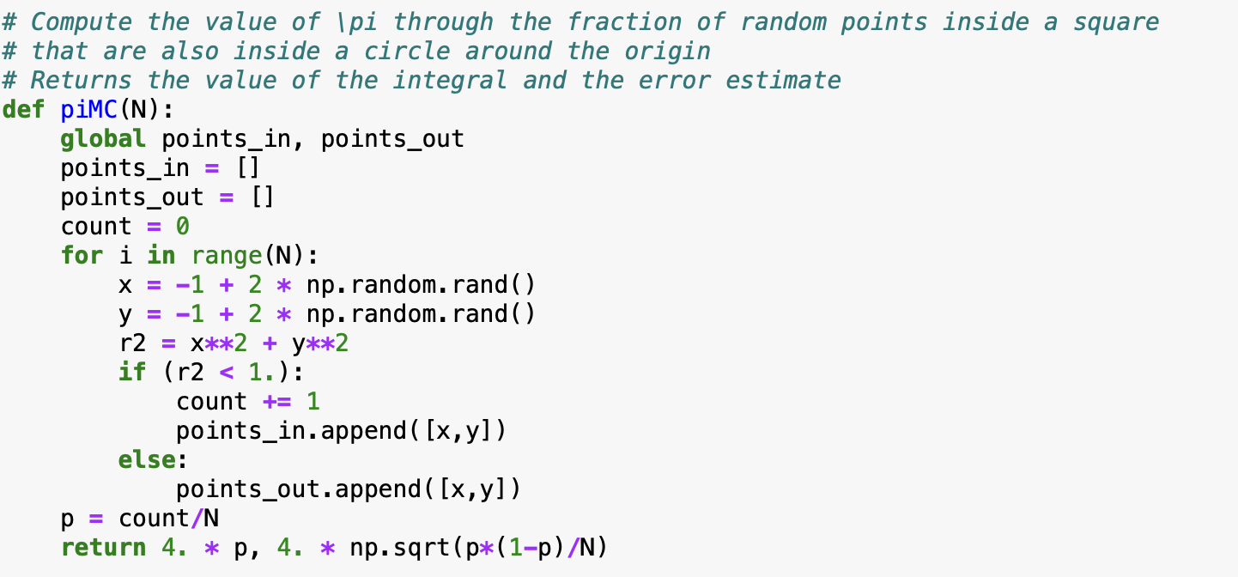
Computing pi

Slide 22
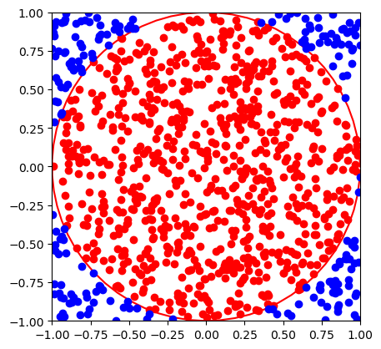
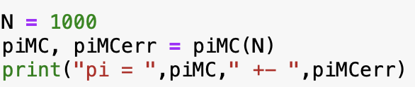
Computing pi
Try a larger number of points

Slide 23
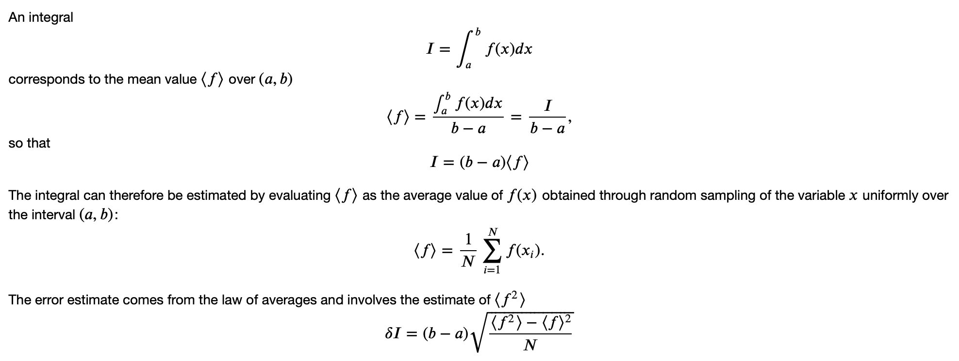
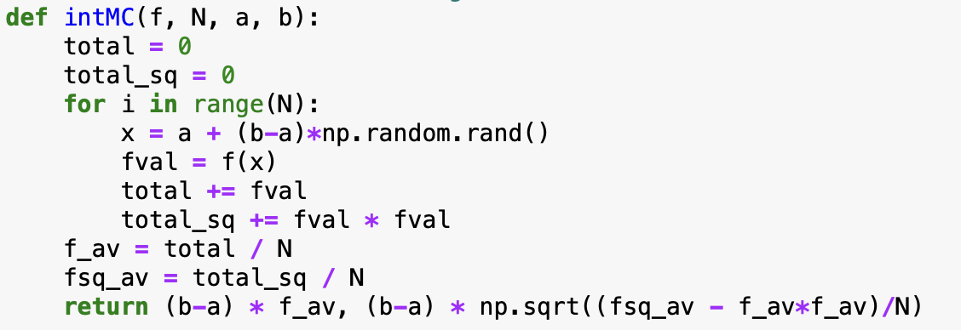
Computing integral as the average

Slide 24
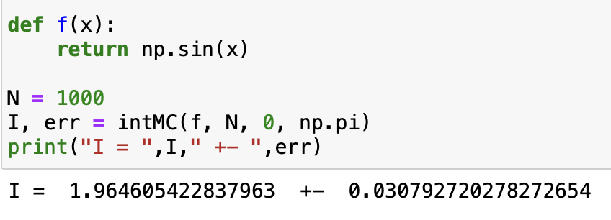
Computing integral as the average
Advantage: the method works also if f(x) is negative, also no need to know its maximum value

Slide 25
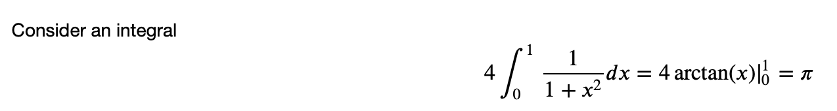
Another way to compute pi

Slide 26
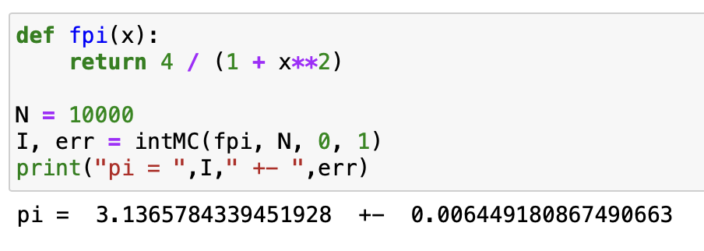
Another way to compute pi

Slide 27
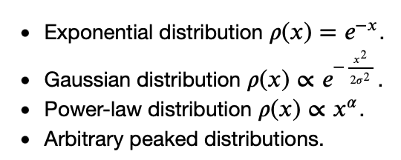
Nonuniformly distributed random numbers
In many cases we deal with random numbers $ξ$ that are distributed non-uniformly.
Common examples are:
There are two common methods for generating nonuniform random variates. They both make use of uniformly distributed variates.
Inverse transform sampling
Rejection sampling

Slide 28
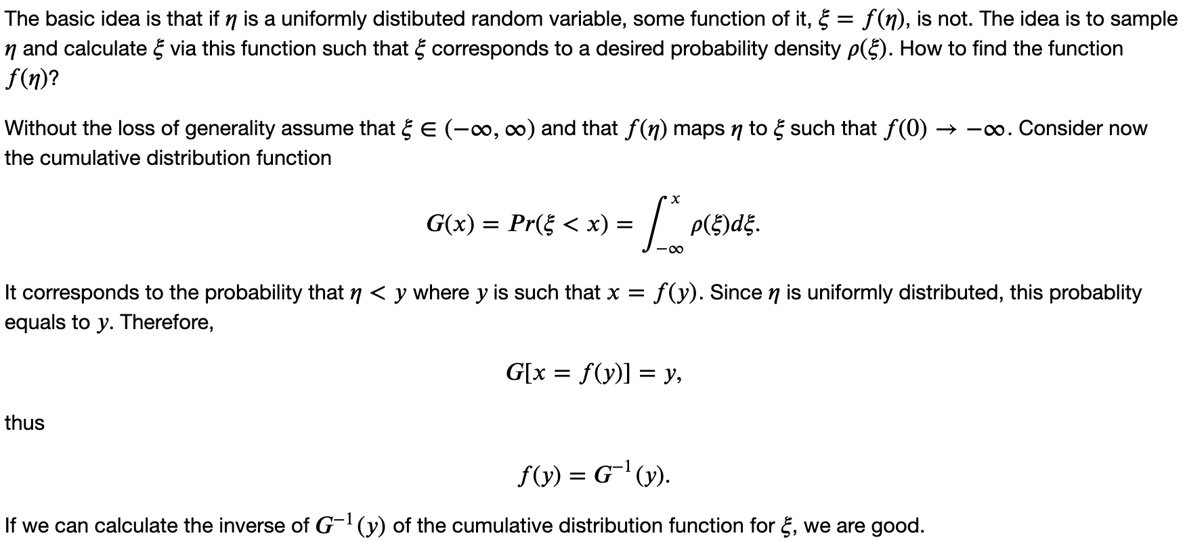
Inverse transform sampling

Slide 29
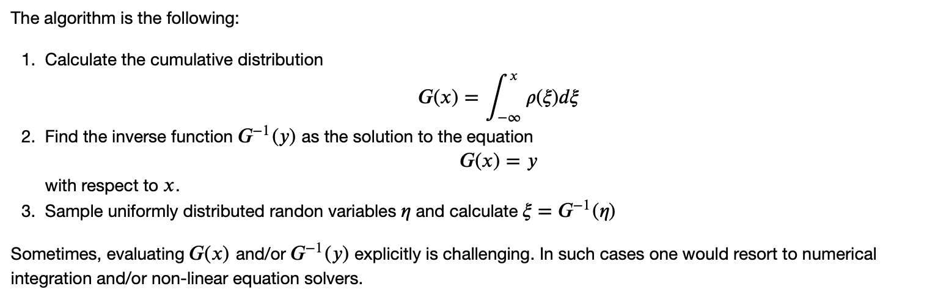
Inverse transform sampling

Slide 30
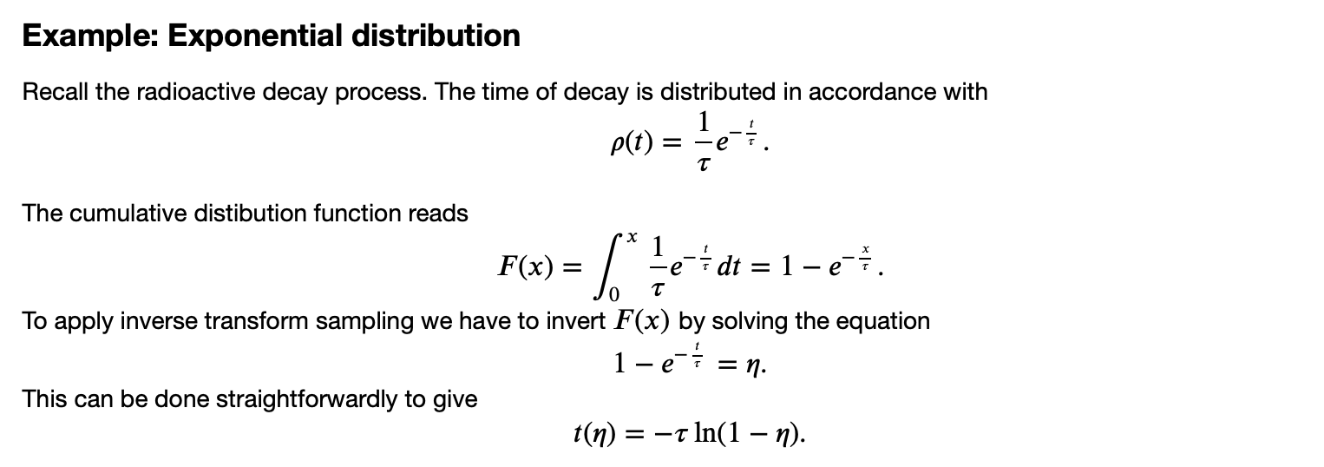
Inverse transform sampling

Slide 31
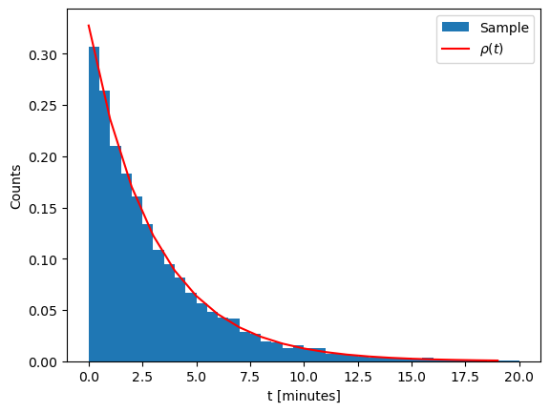
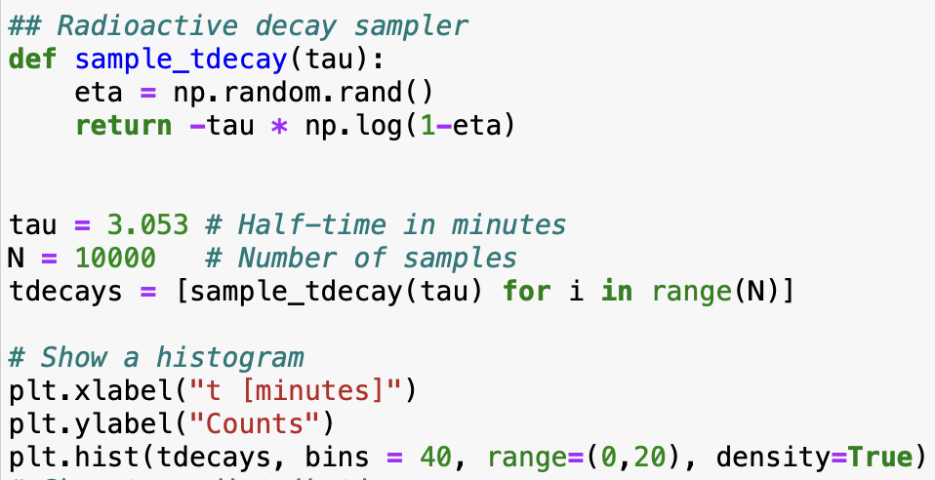
Sampling radioactive decay time

Slide 32
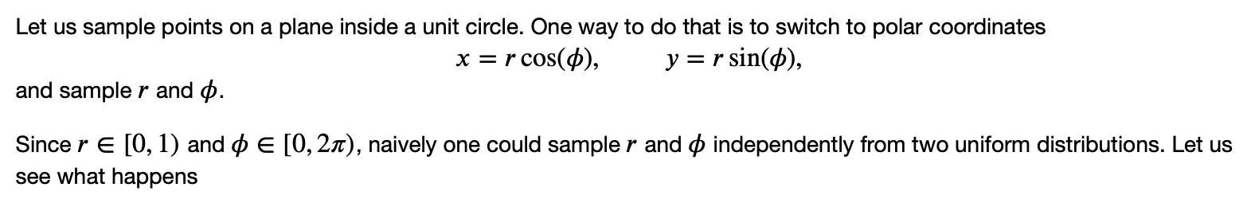
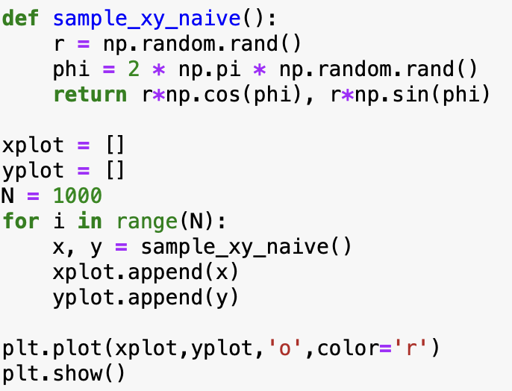
Sampling points inside a circle

Slide 33
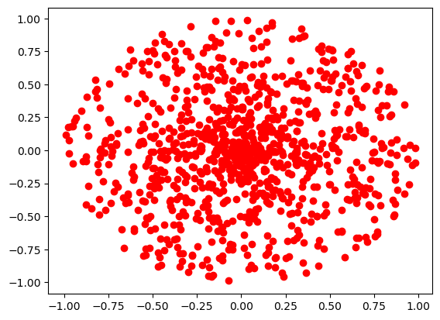
Sampling points inside a circle
The points clump more in the center!

Slide 34
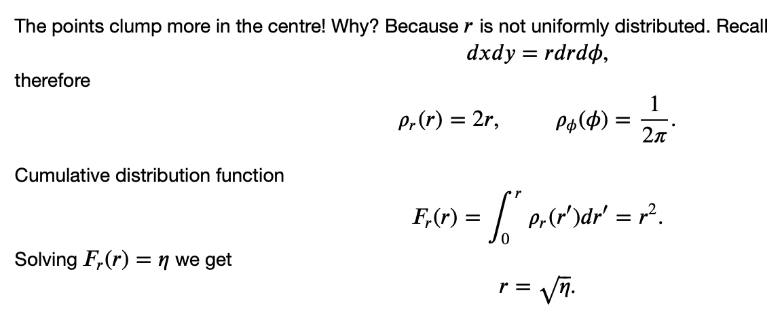
Sampling points inside a circle

Slide 35
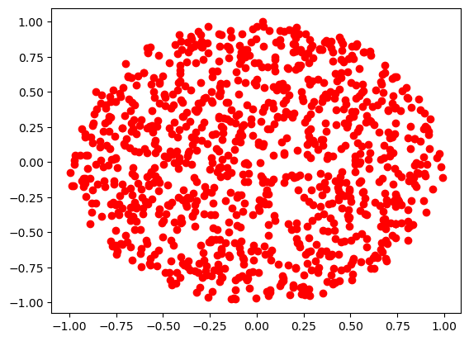
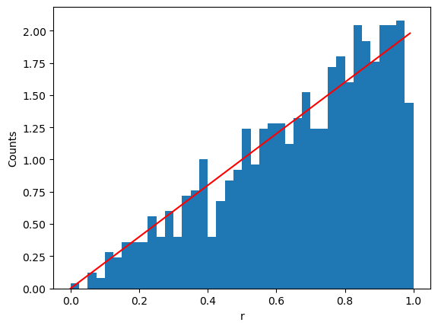

Sampling points inside a circle

Slide 36

Sampling an isotropic direction

Slide 37

Sampling an isotropic direction

Slide 38


Sampling an isotropic direction

Slide 39


Sampling normally distributed variables

Slide 40

Sampling normally distributed variables

Slide 41


Sampling normally distributed variables

Slide 42



Rejection sampling

Slide 43


Rejection sampling

Slide 44

Rejection sampling

